Slide 1
NOTICE!
These materials are prepared only for the students enrolled in the course Distributed Software Development (DSD) at the Department of Computer Science and Engineering, University of Mälardalen, Västerås, Sweden and at the Faculty of Electrical Engineering and Computing, University of Zagreb, Croatia (year 2010/2011).
For all other purposes, authors’ written permission is needed!
The purpose of these materials is to help students in better understanding of lectures in DSD and not their replacement!

Slide 2
Distributed Software Development

Slide 3


Transport4You
Responsible: Dajan Zvekić, Toni Pivčević, Mahdi Sarabi, Gaurav Kushwaha
Final presentation

Slide 4
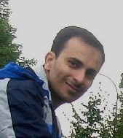
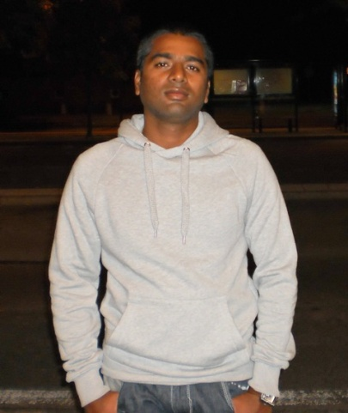
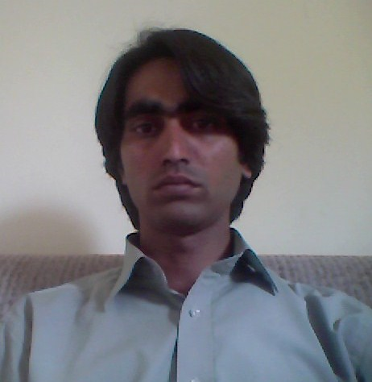
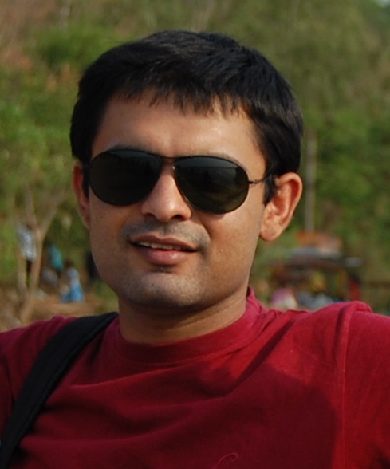
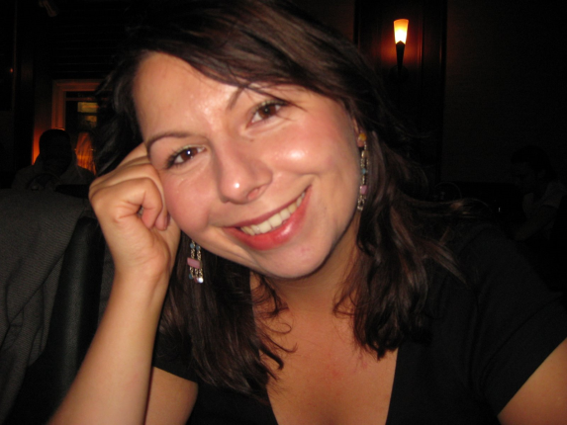
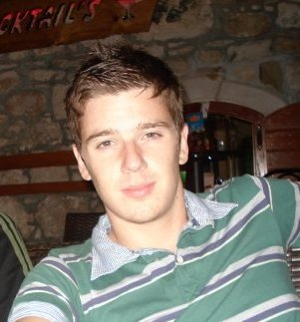
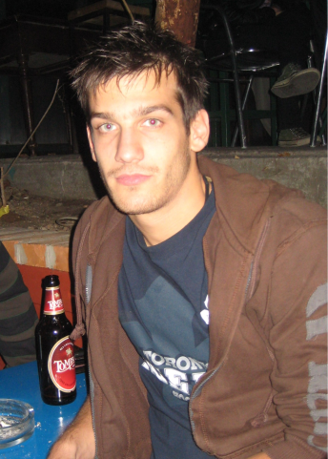
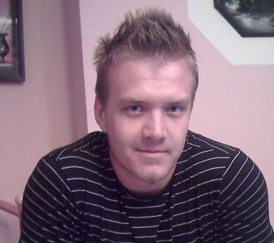
1/10/2010

Slide 5
T4U description
T4U = Transport for You
Project registered in SCORE competition
“T4U project was designed to help organize public transport for big cities, which have many network systems like bus, tram or subway network system. Main goal of the project is to make public transport more reliable and easier to use for people who heavily depends on it. Also, this projects goal is to help in organization of public transport system and automate much functionality that is currently manually executed.”

Slide 6

Important event(s)
T4U SCORE project description document
Currently working on third version of document
80% completed

Slide 7
Working hours
Member | W37 | W38 | W39 | W40 | W41 | W42 | W43 | W44 | W45 | W46 | W47 | W48 | W49 | W50 | W51 | W52 | W1 | Total
Dajan | 18 | 17 | 19 | 13 | 20 | 22 | 13 | 19 | 23 | 24 | 20 | 18 | 22 | 14 | 14 | 25 | 11 | 312
Dino | 13 | 14 | 14 | 8 | 18 | 21 | 17 | 18 | 21 | 26 | 25 | 28 | 31 | 2 | 20 | 8 | 21 | 305
Gaurav | - | 15 | 19 | 16 | 12 | 20 | 15 | 18 | 22 | 23 | 13 | 21 | 19 | 7 | 18 | 0 | 13 | 251
Mahdi | 10 | 17 | 9 | 6 | 9 | 8 | 16 | 14 | 12 | 14 | 9 | 11 | 14 | 0 | 10 | 0 | 14 | 149
Muhammed | 4 | 15 | 11 | 9 | 10 | 10 | 19 | 11 | 16 | 16 | 19 | 14 | 14 | 09 | 0 | 0 | 0 | 179
Toni | 15 | 14 | 17 | 12 | 18 | 22 | 9 | 22 | 22 | 24 | 16 | 19 | 17 | 4 | 11 | 7 | 12 | 261
Vengal | 3 | 9 | 11 | 11 | 7.5 | 6 | 12 | 10 | 12 | 11 | 13 | 8 | 9 | 10 | 10 | 8 | 0 | 150.5
Total | 63 | 101 | 100 | 75 | 95 | 109 | 101 | 112 | 128 | 138 | 115 | 119 | 126 | 46 | 73 | 48 | 57 | 1583

Slide 8

Work statistics
Meetings
2 local MDH / FER (Scrum Daily meeting)
1 MDH + FER (Sprint Planning/Retrospective meeting)
SVN repository
406 commits
2728 file changes
Project
9 subprojects
308 files (java,jsp,html,properties...)
12256 SLOC
79 documents written

Slide 9
Experiences
Positive?
New friends ☺
Good experience of working under pressure
Learning new technologies
New, different way of working & communicating
“Mistakes are the stepping stones to learning”

Slide 10
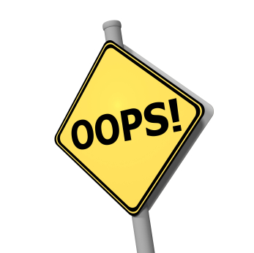

Problems and notes
Work
Unbalanced knowledge of technologies, leads to unbalanced work load.
Learning new technology during course is NOT worth it!
In our opinion, DSD course needs stonger conditions for enrollment.
Language/cultural differences.
Presentations/demos
Takes a lot of time/resources to complete.
Difficulties to demonstrates due to nature of project (no fancy GUI).

Slide 11
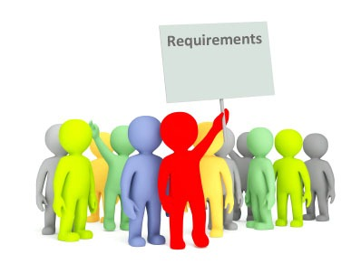
Requirements
Implemented requirements (highlevel):
Smart detection of passengers
Ticket purchase (prepayment,sms)
Automatic billing
Standard route detection
Route modification notification
Not implemented requirement(s):
Route optimization

Slide 12
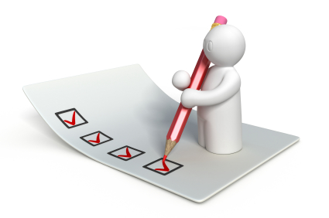
Use cases (1)
Transport Web Application
“User Registers”
“User prepays ticket on web”
“User subscribes to route”
“User prepays tickets in person”
“Admin inserts transport line interruption/modification information”
Transport Main Application
“Transport line interruption/modification notification”
“Transport main application identifies user’s standard routes”
“Transport route optimization notification”

Slide 13
Use cases (2)
Transport Unit Application model use cases
“User performs multiple route section journey”
“Driver starts application”

Slide 14





Technologies Used
Core
Java
Web
JSP
Apache Struts2
js,jquery,ajax
Persistence
MySQL
JPA/Hibernate
Other
GNokki
BlueCove

Slide 15
Arhitecture overview

Slide 16
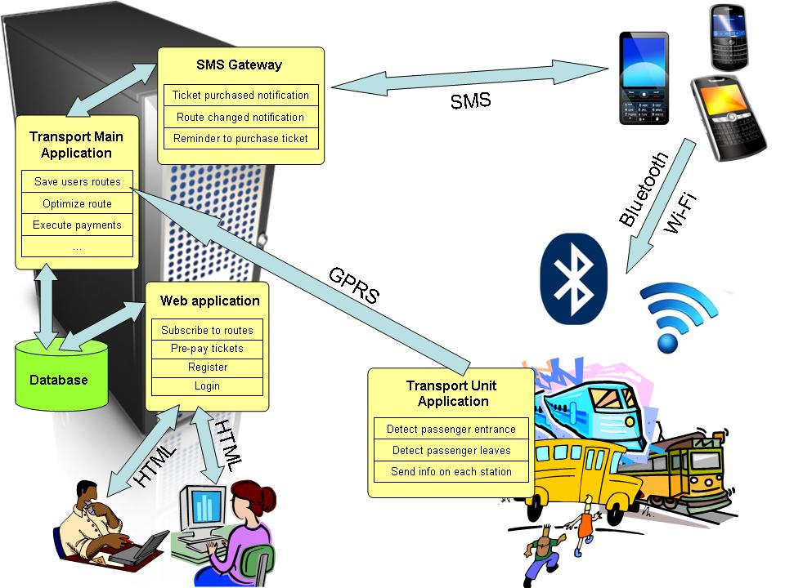

Slide 17

SCORE Communication with customers
Communcation regarding requirements gathering and verification
Requirements confirmed and agreed upon by customers
Communication regarding formal methods
Formal methods project will be submited to SCORE competition with Transport4You project

Slide 18

SCORE Report writing
Motivating and challenging
Iterative process
Currently working on third version
Professor Crnković factor
We are thankful for inputs and comments on initial version of document

Slide 19

Formal methods
Formal methods and what we should expect from it?
Development process and formal methods process
Used tool in formal methods
What did we verified?

Slide 20
Formal methods
In computer science and software engineering, formal methods are a particular kind of mathematically-based techniques for the specification, development and verification of software and hardware systems. [R. W. Butler "What is Formal Methods?".]
It is part of testing
Verifying the requirements and specifications
Mathematical or visual

Slide 21
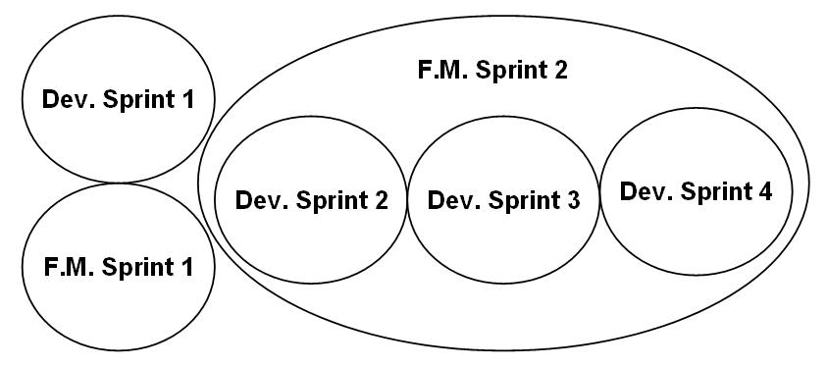
Methodology used in formal methods

Slide 22

Tool used in formal methods
What is UPPAAL?
Model checker for network of timed automata.
used as a tool for:
modeling
simulating
Verifying
What is modeled?
The model is considering a bus with many stations and one passenger.

Slide 23
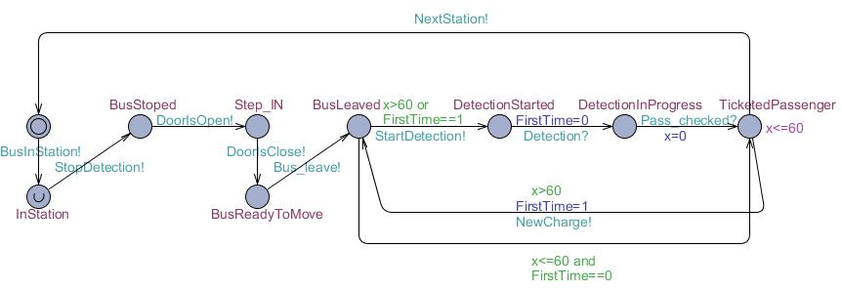
UPPAAL (Model)

Slide 24
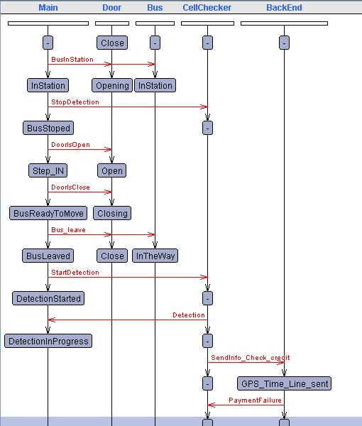
UPPAAL (Simulation)

Slide 25
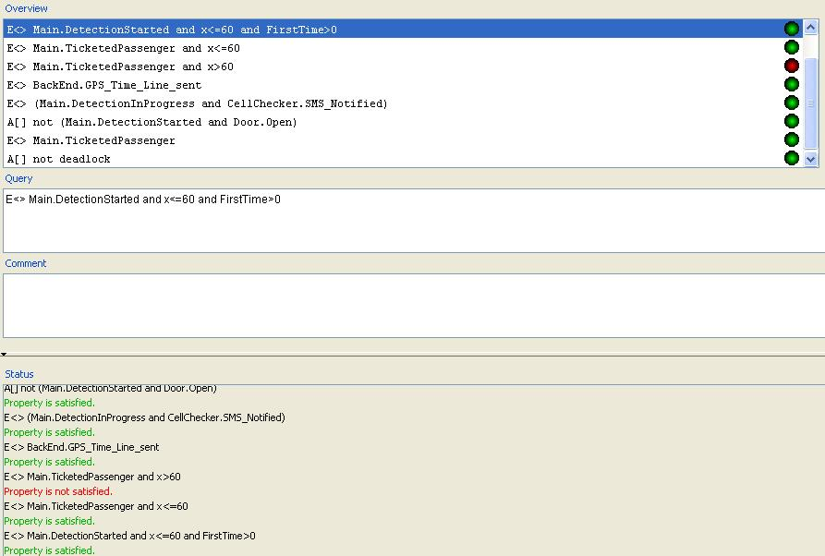
UPPAAL (Verifier)

Slide 26

What we verified in UPPAAL
1. Test cases TMA 1, 2, 3 and TUA 1, 2 from acceptance test plan verified
2. No deadlock in the system.
3. Passenger is ticketed after ticketing issues is handled.
4. The detection started when the doors are closed.
5. Notifications are sent out for all cases of ticket handling.
6. The GPS location, boarding time and line number is sent after detection and when checking.
7. Ticket is valid for 60 minutes only and this test gives a negative result.
8. The ticket is valid for less than or equal 60 minutes and the passenger can stay in the bus for that time.
9. The passenger is ticketed for two reasons first when the passenger enters the transport unit for the first time and the second when the trip time exceed 60 minutes.

Slide 27

Demonstration
Formal methods demo video
&
Live demonstration of system

Slide 28

Transport4You1 Video
For all those who missed our video check it out on youtube:
http://www.youtube.com/watch?v=59NOsOxOEB4

Slide 29

Questions

Slide 30


